Slide 1


Bren Jay Magtalas
November 23, 2022

Slide 2

Outline
Executive Summary
Introduction
Methodology
Results
Conclusion
Appendix

Slide 3
Executive Summary
The data used was collected though web scrapping and API. The categorical data was transformed to numerical equivalent and some missing data were replace by the mean. Different graphs were used for exploratory data analysis to gain initial insights in the data. The data was then used to make a model based on classification methods.
The exploratory data analysis resulted in the insight that as flight number, payload and year increases, the success rate also increases. Graphing the launch sites on the map, it can be deduced that all of them are near coastline. In terms of classification accuracy for all models, they resulted in the same value. Finally, based on the confusion matrix, the model has perfect recall and 0.8 precision making it a good predictor in the landing success.

Slide 4
Introduction
SpaceY, a newly founded company, is investigating the success rate of landing a reusable first stage rocket.
The company wants to create a model that predicts the landing success rate of a reusable rockets based on the historic data available from SpaceX Falcon 9 rocket.

Slide 5

Section 1

Slide 6
Methodology
Executive Summary
Data collection methodology:
The data is collected from the publicly available SpaceX API and web scrapping from Wikipedia SpaceX webpage.
Perform data wrangling
The data was transformed by assigning a numerical value to the target variable which is the landing outcome.
Perform exploratory data analysis (EDA) using visualization and SQL
Perform interactive visual analytics using Folium and Plotly Dash
Perform predictive analysis using classification models
The data is first split into training and testing set. The training set is trained through different machine learning algorithms and the model is evaluated using the testing set.

Slide 7
Data Collection
The data set is collecting using the SpaceX API and web scrapping from the Wikipedia SpaceX page.

Slide 8
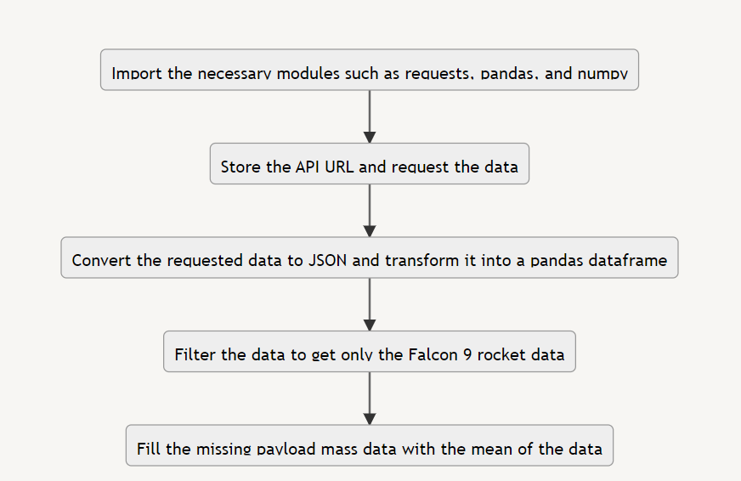
Data Collection – SpaceX API
https://github.com/BrenJay23/Capstone/blob/main/Data_Collection_API_MJmRZv-os.ipynb
Place your flowchart of SpaceX API calls here

Slide 9
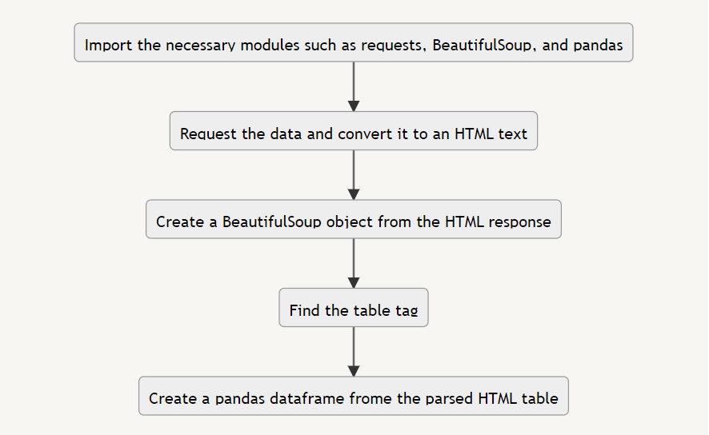
Data Collection - Scraping
https://github.com/BrenJay23/Capstone/blob/main/Data_Collection_with_Web_Scrapping_Cycu4EXqN.ipynb
Place your flowchart of web scraping here

Slide 10
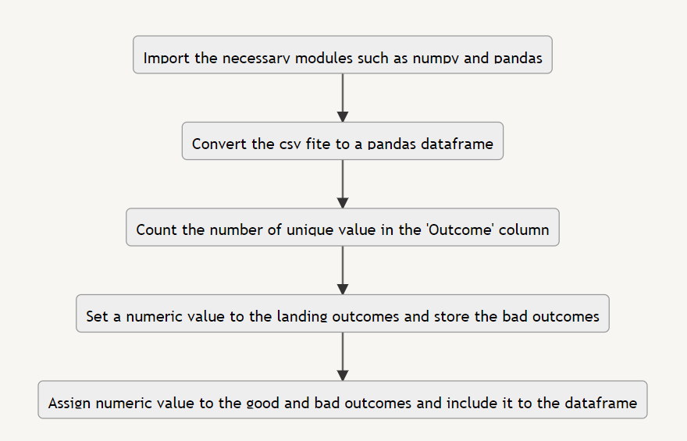
Data Wrangling
The data was transformed by assigning a numerical value to the target variable which is the landing outcome.
https://github.com/BrenJay23/Capstone/blob/main/Data_Wrangling_yhltyHgOR.ipynb

Slide 11
EDA with Data Visualization
The Scatter Plot was used to illustrate how the rocket is more likely to land as independent variables such as flight number and payload mass increases per category. The plots were categorized based on payload mass, launch site and orbit. It was used to show and compare the number of data points per category
The Bar Graph was used to show the success rate of the landing per orbit destination. It was used to differentiate categories.
The Line Graph was used to illustrate the cumulative success rate per year. It was used to show time-series data.
https://github.com/BrenJay23/Capstone/blob/main/EDA_with_Visualization_LLcl2Wo8L.ipynb

Slide 12
EDA with SQL
The csv files were first loaded into the DB2 database
The date format was modified to match the file
Modules such as sqlalchemy and iphython-sql were intalled
The DB2 credentials were fetched and used in the sql magic
The queries can now be typed in the python notebook like a regular SQL IDE by initially typing %%sql
https://github.com/BrenJay23/Capstone/blob/main/EDA_with_SQL_1sovnRZCy.ipynb

Slide 13
Build an Interactive Map with Folium
Markers were used to indicate the name of the launch site and other labels
Marker Cluster was used to unclutter and cluster overlapping launch sites
Circles were used to make the coordinate more visible
Lines were used to illustrate the proximity of the launch site to other type of areas
https://github.com/BrenJay23/Capstone/blob/main/Data_Visualization_with_Folium_NsGx9U3Zr.ipynb

Slide 14
Build a Dashboard with Plotly Dash
Dropdown list was added to enable the user to choose which launch site graphs they want to see
Pie Chart was used to show the percentage of success launch per site and as a whole
Scatter Plot was used to show the correlation between the weight of the payload and successful landings
Range Slider was used to allow the user to adjust the range of the payload mass in the scatter plot
https://github.com/BrenJay23/Capstone/blob/main/spacex_dash_app.py

Slide 15
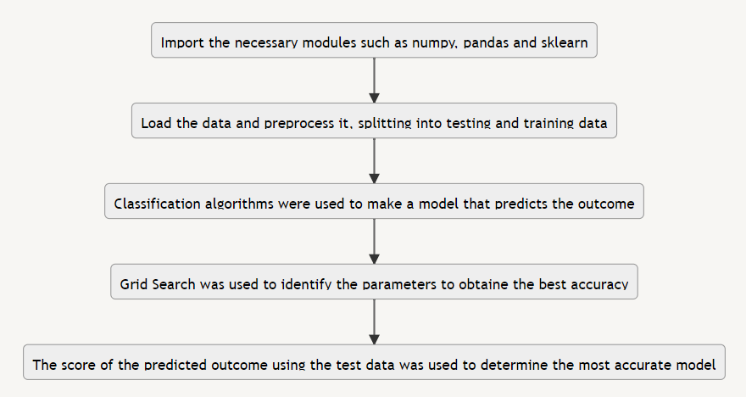
Predictive Analysis (Classification)
The data is first split into training and testing set. The training set is trained through different machine learning algorithms and the model is evaluated using the testing set.
https://github.com/BrenJay23/Capstone/blob/main/SpaceX_Machine_Learning_Prediction_Part_5.jupyterlite.ipynb

Slide 16
Results
Exploratory data analysis results
Interactive analytics demo in screenshots
Predictive analysis results

Slide 17

Section 2

Slide 18
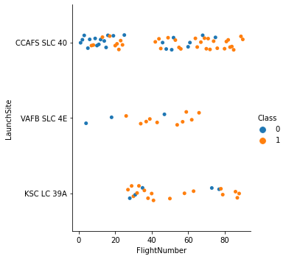
Flight Number vs. Launch Site
There are relatively more successful landing in VAFB SLC 4E launch site.
The higher end of Flight number have significantly more success for all the launch sites

Slide 19
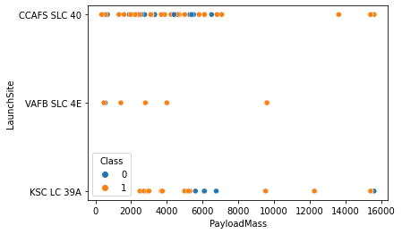
Payload vs. Launch Site
There is a higher number of success in heavier payloads for all launch sites.
Lighter payload in KSC LC 39A also have a high success number

Slide 20
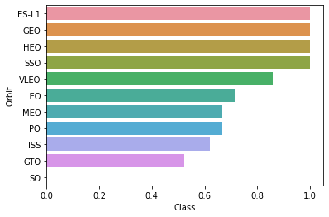
Success Rate vs. Orbit Type
The ES-L1, GEO, HEO and SSO orbits have a 100% success landing rate
SO orbit have zero success landing rate

Slide 21
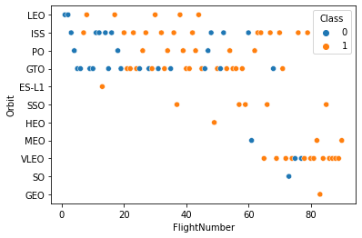
Flight Number vs. Orbit Type
As Flight Number increases, the likelihood of successful landing for all orbits also increases

Slide 22
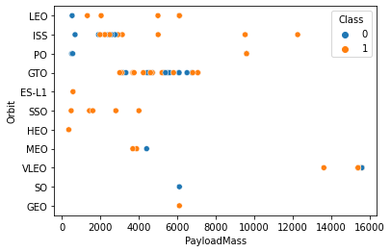
Payload vs. Orbit Type
As Payload Mass increases, the likelihood of successful landing also increases

Slide 23
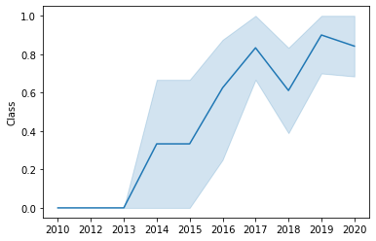
Launch Success Yearly Trend
As the year progresses, he likelihood of successful landing increases

Slide 24
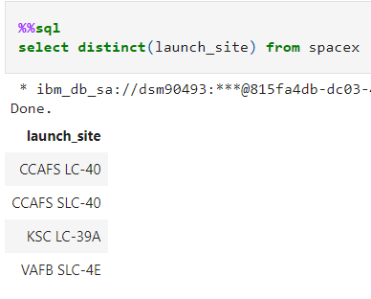
All Launch Site Names
The distinct finds the unique data from a column

Slide 25
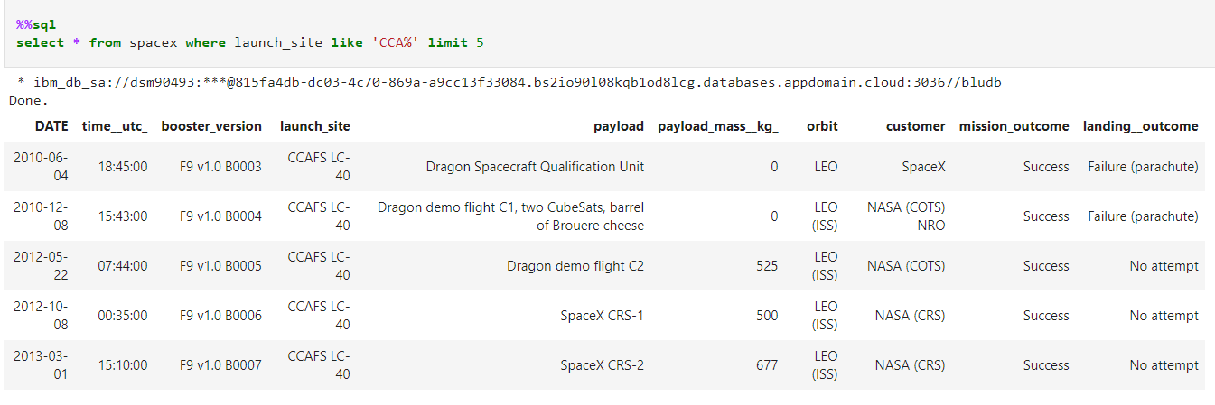
Launch Site Names Begin with 'CCA'
The limit truncate the data to a specified number of rows

Slide 26
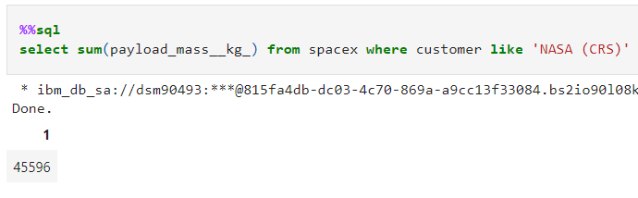
Total Payload Mass
The sum gets the total amount accumulated in a column and like finds the string in a column with the same value

Slide 27
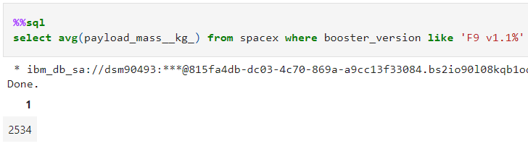
Average Payload Mass by F9 v1.1
The avg averages the specified column and adding % to a string after the like tells that the string can be preceded or succeeded by other characters

Slide 28
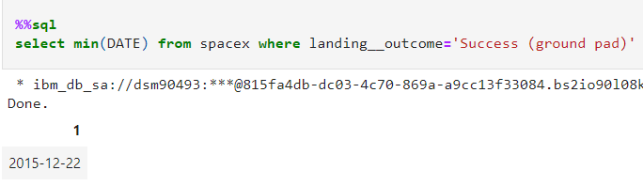
First Successful Ground Landing Date
The min finds the minimum value in the table

Slide 29
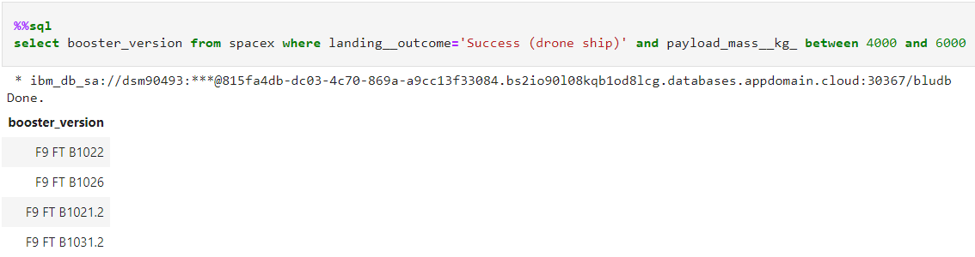
Successful Drone Ship Landing with Payload between 4000 and 6000
The between finding the columns with values that are less than or greater than the two values specified

Slide 30
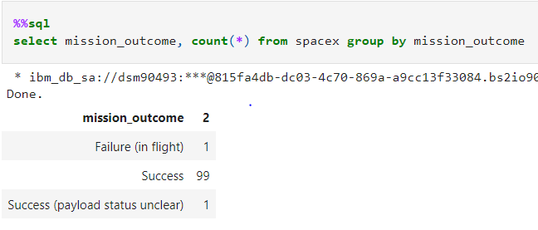
Total Number of Successful and Failure Mission Outcomes
The group by categorize the specified column and count tallies the number of instances in each category

Slide 31
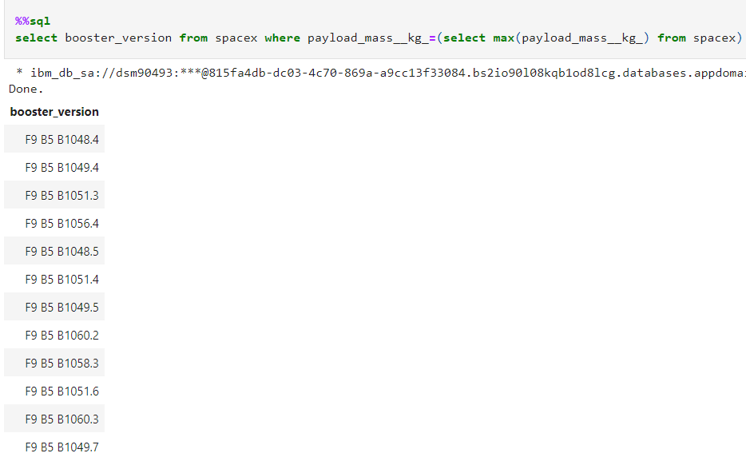
Boosters Carried Maximum Payload
The max can’t be used in the where clause so a subquery is created to get the max payload

Slide 32
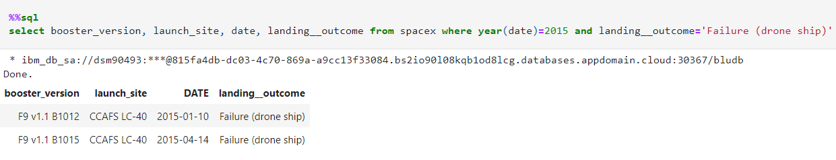
2015 Launch Records
The year can be used in columns with date format to query a specific day, month or year

Slide 33
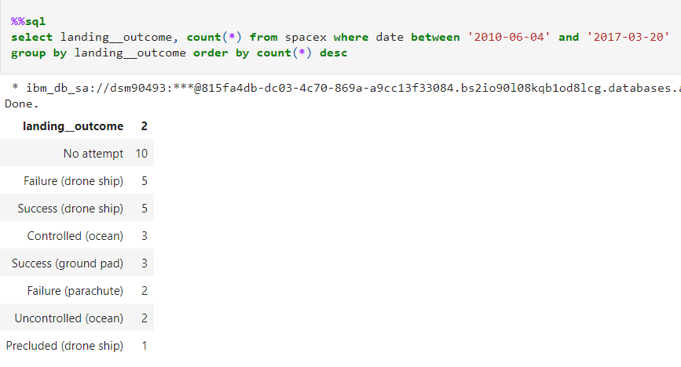
Rank Landing Outcomes Between 2010-06-04 and 2017-03-20
The order by ranks the value in a column and by adding desc, the values are arranged in descending order

Slide 34

Section 3

Slide 35
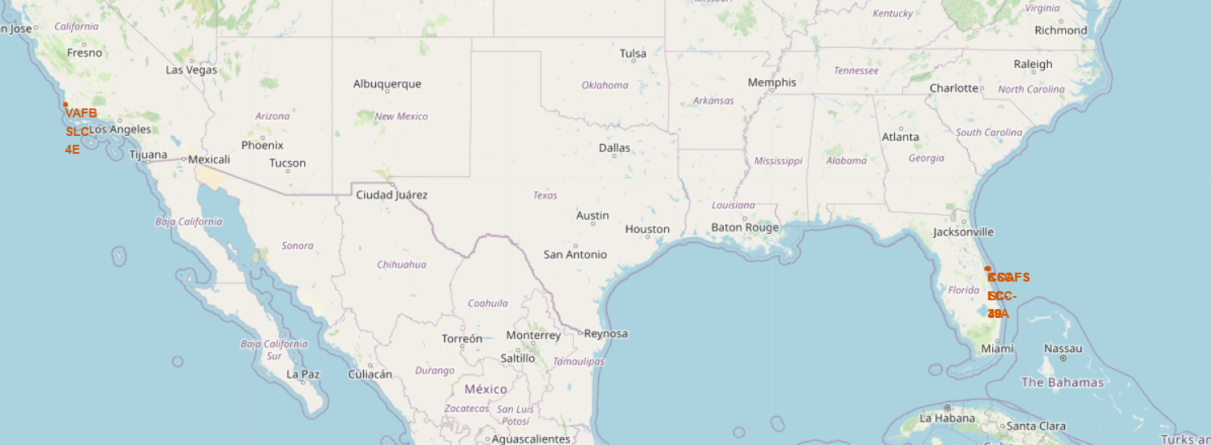
Landing Sites with Circles and Markers
The launch sites were located using circles and marked by their names. Three of the landing sites were very close and overlapping with each other

Slide 36
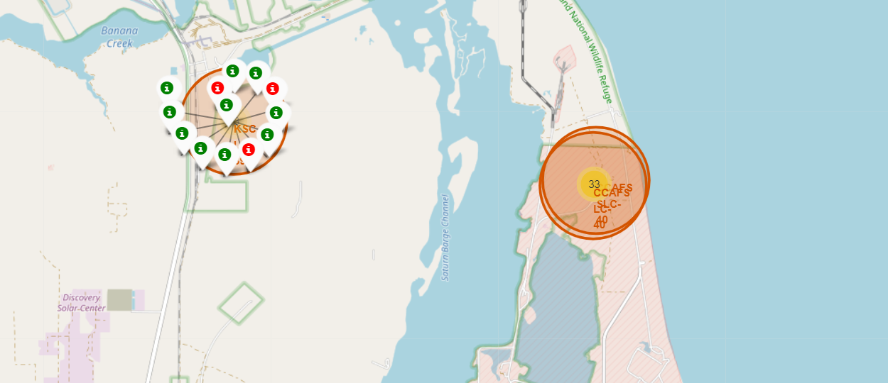
Landing Sites with Marker Cluster
A marker cluster was added in the map, and it made the overlapping launch sites more comprehensible due to the indicated number of same coordinates

Slide 37
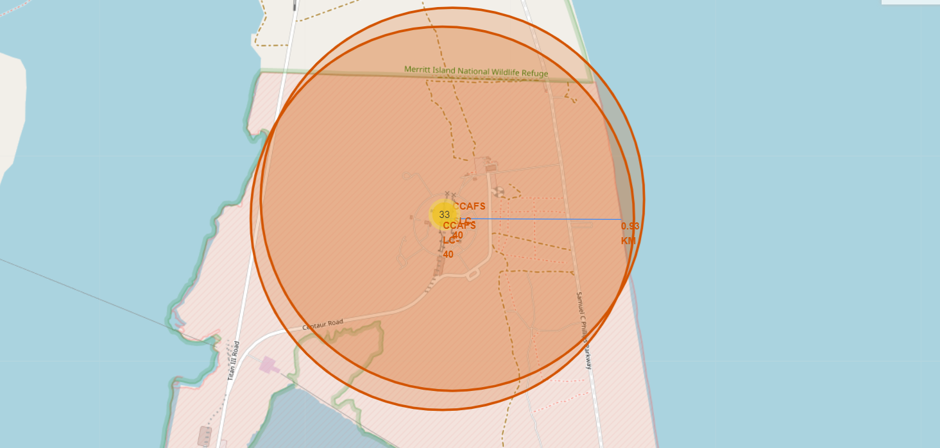
Launch Site with Line
A line with its distance was added to the map indicating its proximity to the shoreline

Slide 38

Section 4

Slide 39
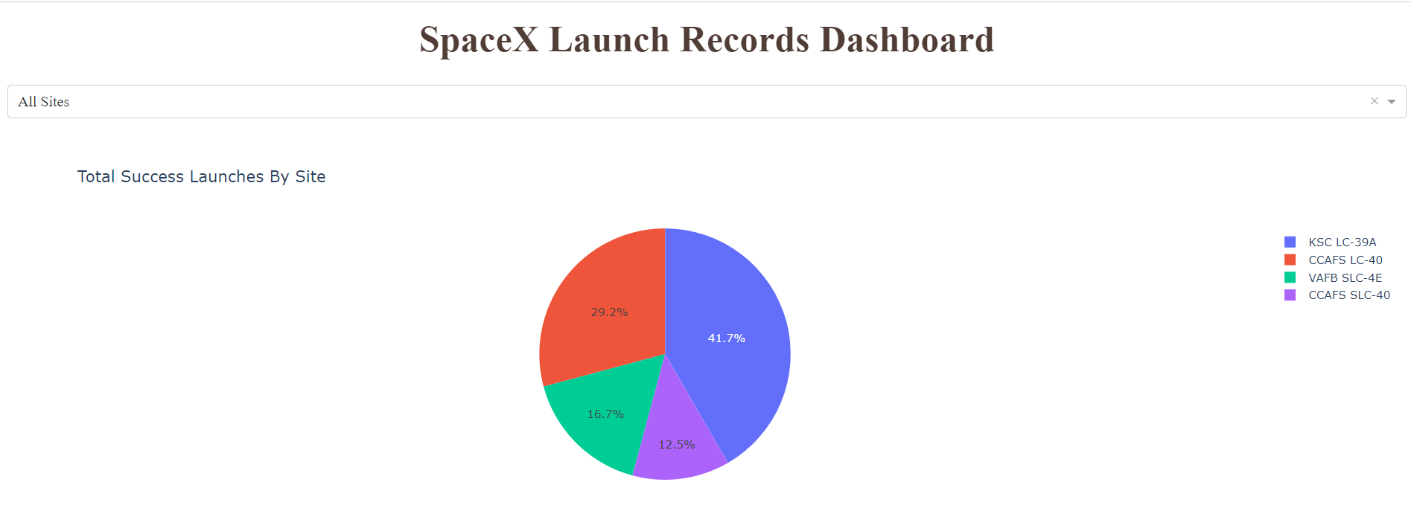
Total Success Launches by Site
The pie chart is used to illustrate the part or amount represented by a variable relative to the whole. The launch site with the highest success count is KSC LC-39A

Slide 40
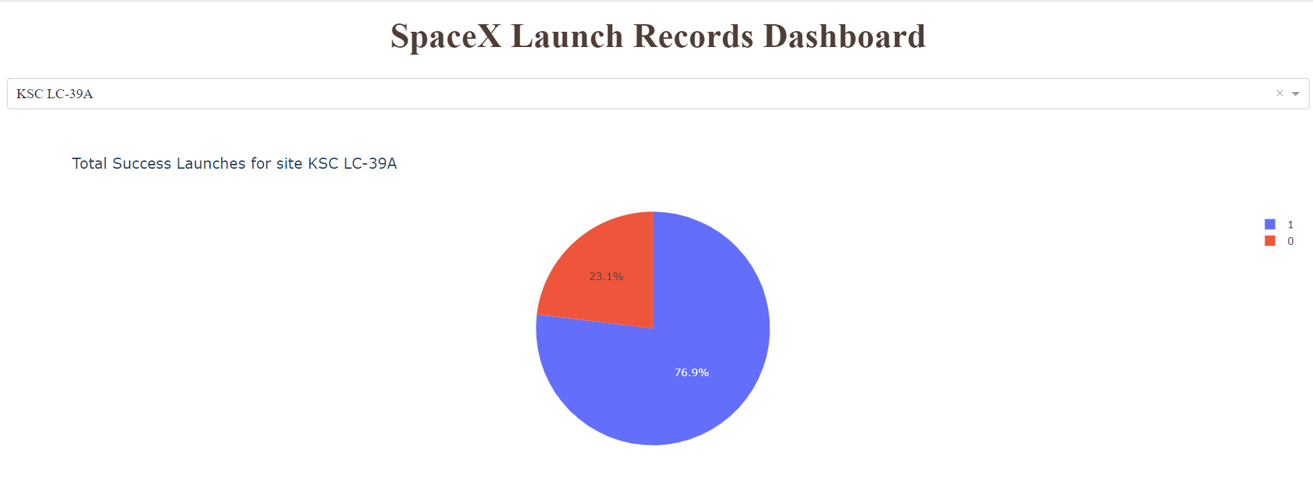
Success Launches for Site KSC LC-39A
The number 1 is used to represent success and 0 for the failed landing. The launch site with the highest success rate, with 76.9%, is KSC LC-39A.

Slide 41
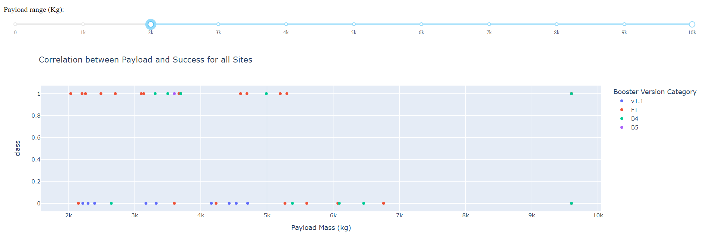
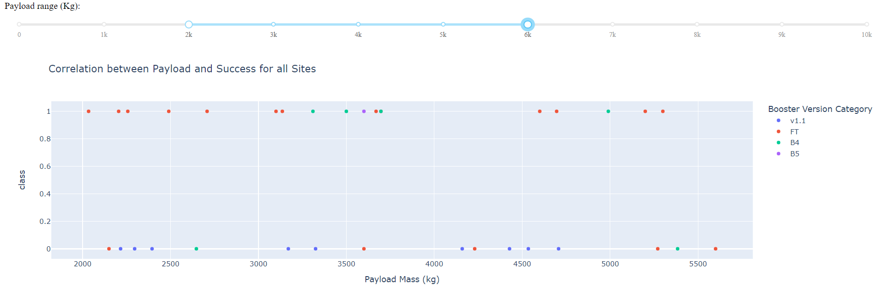
Correlation between Payload and Success for all Sites
The payload range with the highest success rate is between 9000 and 10000 kg. The Booster version with the highest success rate is FT.

Slide 42

Section 5

Slide 43
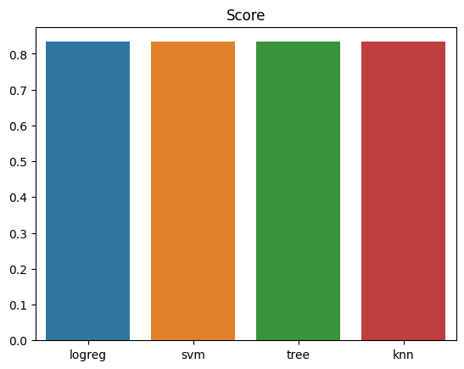
Classification Accuracy
All the models have the same classification accuracy

Slide 44

Confusion Matrix
The model has a perfect Recall, a 0.8 precision. It is a very good at predicting landing that resulted in a success.

Slide 45
Conclusions
As Flight Number increases and the year progresses, the success rate also increases
The heavier Payload have higher success rate
The Launch Sites are all near the coastline
The four classification methods have the same accuracy value
The confusion matrix resulted in a perfect recall and 0.8 precision

Slide 46
Appendix
https://github.com/BrenJay23/Capstone.git

Slide 47


